Slide 1
IOT & M2M

Slide 2
M2M
M2M, or machine-to-machine, is a direct communication between devices using wired or wireless communication channels.
M2M refers to the interaction of two or more devices/machines that are connected to each other.
Machine-to-machine communication, or M2M, is exactly as it sounds: two machines “communicating,” or exchanging data, without human interfacing or interaction. uptake of both M2M and IoT solutions will increase dramatically.
These devices capture data and share with other connected devices, creating an intelligent network of things or systems.
Since non-IP based protocols are used within M2M area networks, the M2M nodes within one network cannot communicate with nodes in an external network.

Slide 3
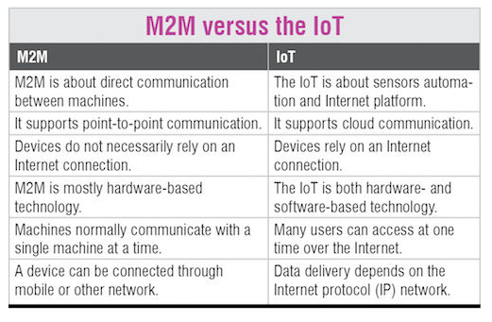

Slide 4
IOT & M2M
IOT is an evolution of M2M that increases the things that device connectivity can achieve at both a consumer and an enterprise level.
IoT takes the basic concepts of M2M and expands them outward by creating large “cloud” networks of devices that communicate with one another through cloud networking platforms.
The technologies used by IoT devices allow users to create fast, flexible, high-performance networks that connect a wide variety of devices.

Slide 5
Point-to-point communication :
M2M system uses point-to-point communication. An IoT system, meanwhile, typically situates its devices within a global cloud network that allows larger-scale integration and more sophisticated applications.
Scalability:
IoT is designed to be highly scalable since devices can often be added to a network and integrated into existing systems with minimal hassle. M2M networks can also be more labor-intensive to set up and maintain, since new point-to-point connections must be created for each device. Wireless devices :
Wireless devices :
The term “IoT” also typically refers to wireless devices, while M2M may or may not involve wireless communication. The wireless nature of most IoT devices can be both a blessing and a curse, requiring less maintenance of technologies such as Ethernet networks but shifting the burden to WiFi networks, which can be less reliable and have problems of their own.

Slide 6
Communication Protocols
M2M uses either proprietary or non-IP based communication protocols for communication within the M2M area networks.
Machines in M2M vs Things in IoT
The "Things" in IoT refers to physical objects that have unique identifiers andcan sense and communicate with their external environment (and user applications) or their internal physical states. M2M systems, in contrast to IoT, typically have homogeneous machine types within an M2M area network.

Slide 7
Hardware vs Software Emphasis
While the emphasis of M2M is more on hardware with embedded modules, the emphasis of IoT is more on software.
Data Collection & Analysis
M2M data is collected in point solutions and often in on-premises storage infrastructure.In contrast to M2M, the data in IoT is collected in the cloud (can be public, private or hybrid cloud).
Applications
M2M data is collected in point solutions and can be accessed by on-premises applications such as diagnosis applications, service management applications, and onpremisis enterprise applications. IoT data is collected in the cloud and can be accessed by cloud applications such as analytics applications, enterprise applications, remote diagnosis and management applications, etc.

